Slide 1
YOM KIPPUR WAR:
BACKGROUND AND BREAKOUT
סדנא-1

Slide 2
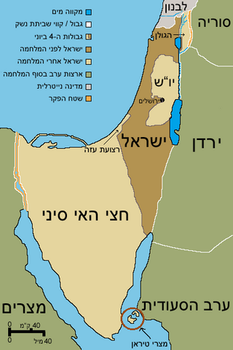
The Yom Kippur War - Tishrei 10 - 5734; October 6, 1973
The Yom Kippur War broke out fifty years ago on Yom Kippur 5734, October 6, 1973. In a joint effort led by Egypt and Syria a coalition of Arab armies, including Jordan and Iraq, attacked Israel. The war took place primarily in the Sinai and the Golan Heights and lasted until October 24, 1973 when the cease fire took effect.
Golan Heights
Sinai

Slide 3
The Yom Kippur War - Tishrei 10 - 5734; October 6, 1973 - War Background
Background: The Two Prior Wars
The Six Day War: June 5-10, 1967. This war was between Israel and Egypt, Syria and Jordan with some assistance form Iraq, Lebanon, and Saudi Arabia. The war concluded with a very clear Israeli victory in which Israel captured vast areas of the Sinai, the Gaza Strip, The Golan Heights, the Yehudah and Shomron, and East Jerusalem. Israel tripled its pre-war size.
The War of Attrition: Egypt and Israel - June 11, 1967 - August 7, 1970. Egypt wanted to pressure Israel to abandon the areas she captures during the Six Day War, or at least to force Israel to retreat from the Suez Canal to allow for ships to pass through. Concurrent with this war there was also a war of attrition in the Jordan Valley.

Slide 4
The Yom Kippur War - Tishrei 10 - 5734; October 6, 1973 Match the number of Israeli soldiers killed wit the war
The war of Attrition
The Yom Kippur War
The Six Day war
780
968
2,569

Slide 5
The Yom Kippur War - Tishrei 10 - 5734; October 6, 1973
What were the attitudes after the Six Day War that influenced the results of the Yom Kippur War?
Show the video and afterwards some pictures that will help answer the questions )pictures in the slides or in attached appendix)

Slide 6
The Yom Kippur War - Tishrei 10 - 5734; October 6, 1973
War background – The Six Days War Video: The bombing of Egyptian air force bases in 1967

Slide 7
Workshop Pictures from the Six Day War

Slide 8
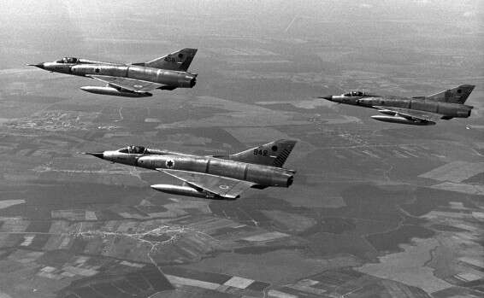
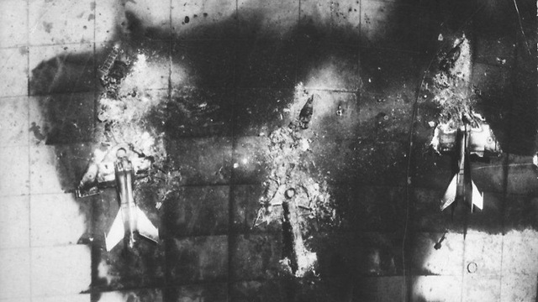
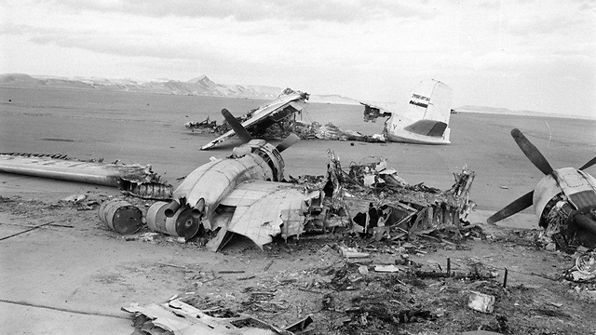
The Yom Kippur War - Tishrei 10 - 5734; October 6, 1973
War background – The Six Days War Pictures of the Israeli Air Force bombing Egyptian air force bases on the first day of the Six Day War.

Slide 9
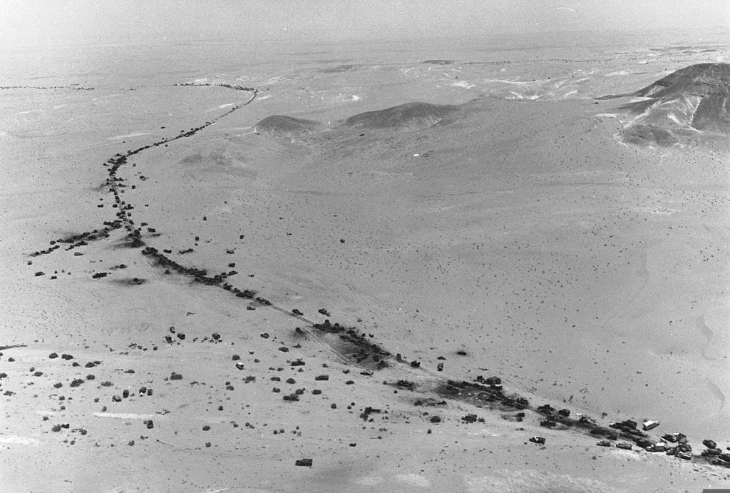
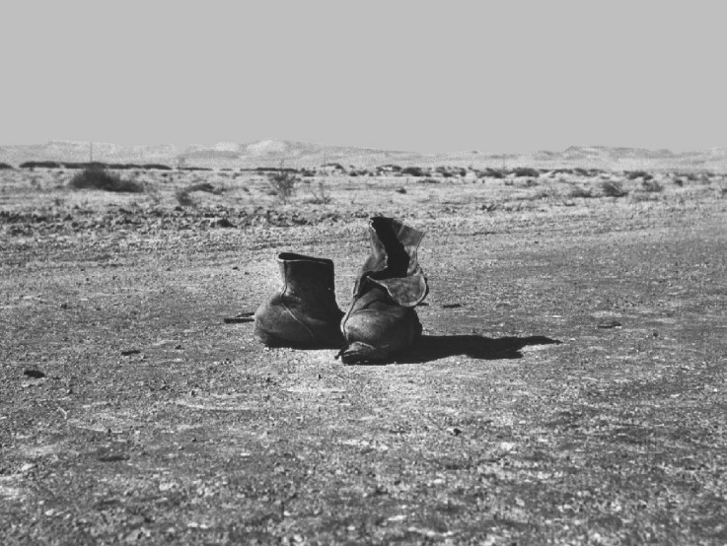
The Yom Kippur War - Tishrei 10 - 5734; October 6, 1973
War background – The Six Days War Pictures of the shoes Egyptian soldiers abandoned while fleeing

Slide 10
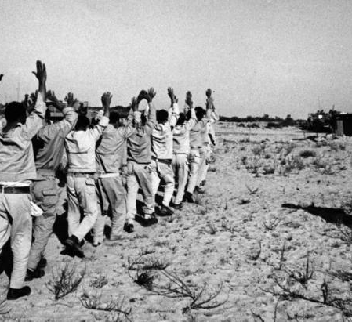
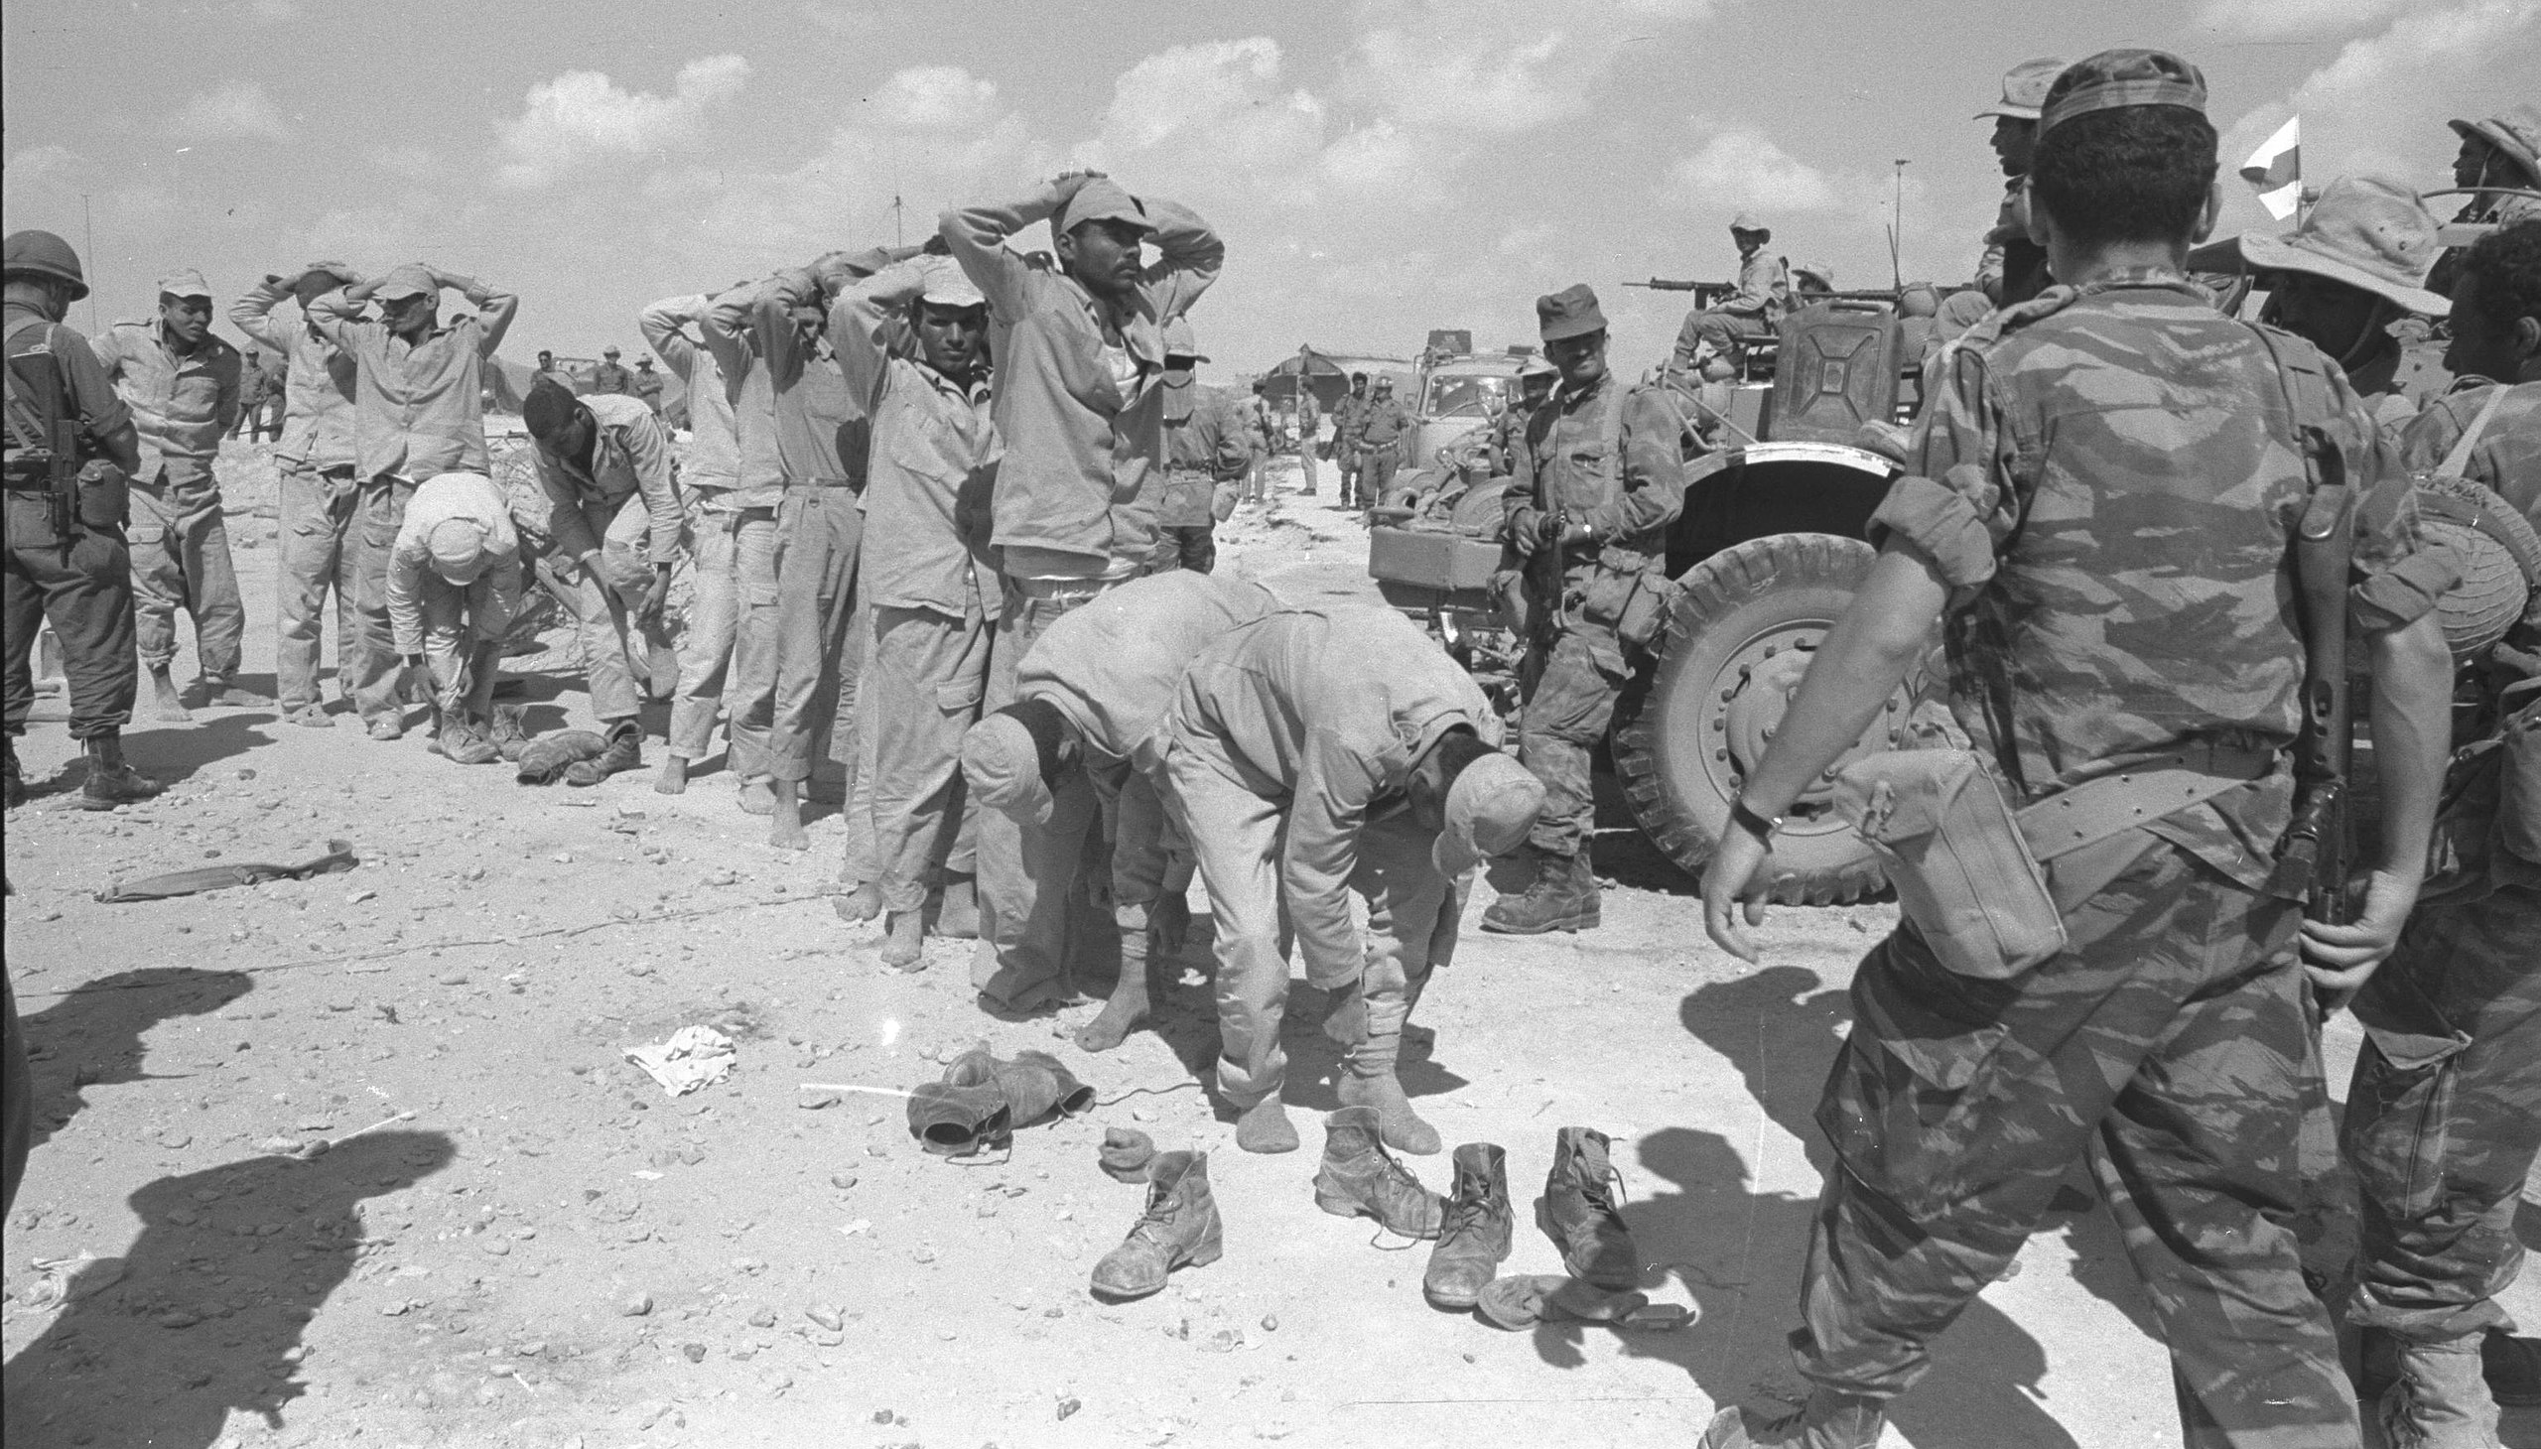
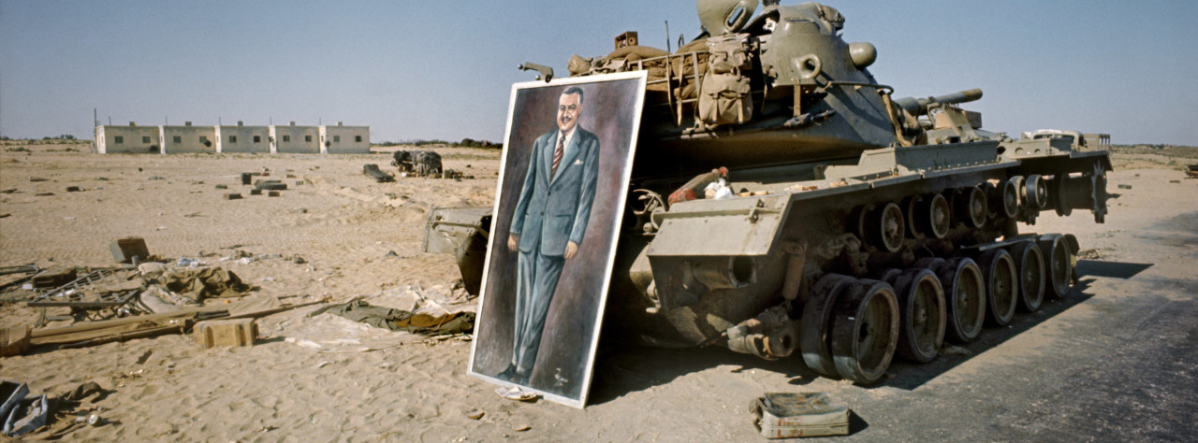
Pictures of Egyptian soldiers surrendering

Slide 11
The Yom Kippur War - Tishrei 10 - 5734; October 6, 1973
Describe what you see in the pictures
In your opinion what do you think were the Israeli attitudes about the Arab soldiers after the war?
What did the leaders think?
Discussion:

Slide 12
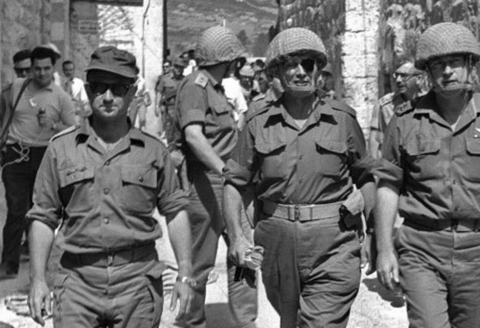
Assumptions after the Six Day War
The IDF has a substantial advantage over the Arab armies
It will take many years for the Arab armies to rebuild their armies to the point of constituting a serious threat to Israel

Slide 13
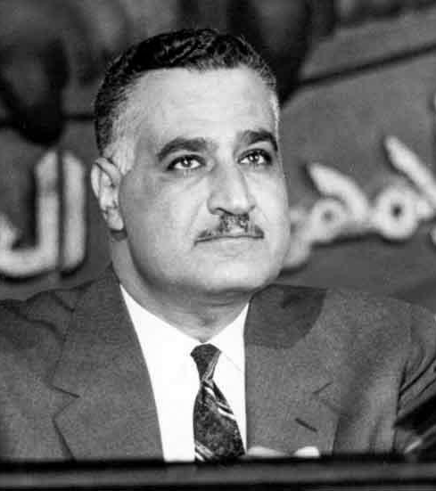
Immediately following the Six Day War (June 1967) the War of Attrition began (June 11, 1967 - August 7, 1970)
At the conclusion of the Six Day War a new reality existed after the Arab armies were defeated and Israel captured the Sinai Peninsula from Egypt, the Yehudah and Shomron from Jordan and the Golan Heights from Syria. Israel tripled its pre-war area. After the Six Day War, Gamal Abdel Nasser, the president of Egypt declared:
“I can’t conquer the Sinai, but I can exhaust Israel.”
He therefore initiated immediately after the Six Day war a war of attrition that lasted three years along the Egyptian, Syrian, and Jordanian fronts. The main battle area was the Suez Canal region. The Egyptians shelled the Israel positions and launched cross-canal commando raids.
A large quantity of arms was given to Egypt by the Soviet Union including advanced SAM anti-aircraft missile batteries and SAGAR anti-tank missiles.
In this war Israel had air superiority while Egypt had the advantage in weaponry that she received from the Soviet Union
There were many casualties on both side sin this war
The cease fire went into effect on August 7, 1970

Slide 14
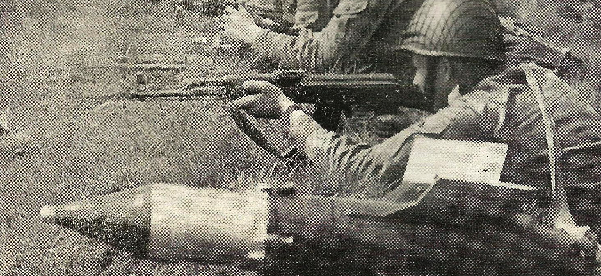
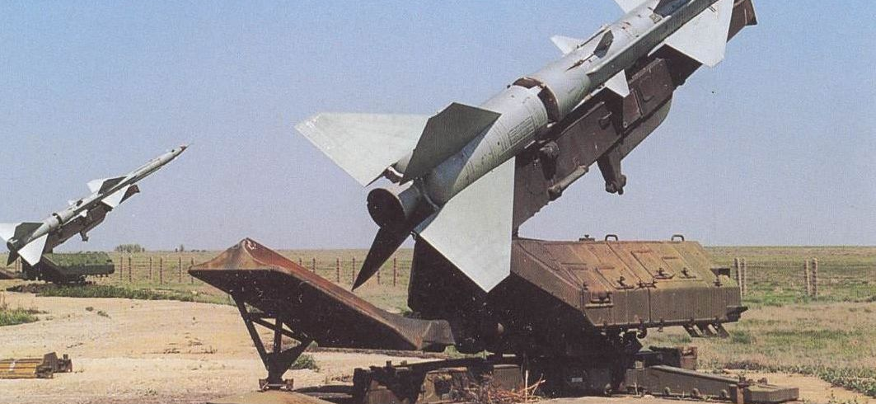
Assumptions after the war of Attrition
Israel failed to prepare properly to defend against the SAM and SAGAR missiles
Despite suffering many casualties Israel failed to identify changes in the Egyptian battle doctrine and force development

Slide 15
Conclusions :
Israel was not properly prepared for the war. She therefore suffered a high amount of wounded and killed soldiers.
People, and especially leaders, must learn lessons after victories and not only after defeats.
We cannot be blinded by victory. Hubris can lead to disaster. Humility saves lives.
Never denigrate an opponent. Remember that an opponent also learns from failures and is constantly improving.
One must always be up to date with developing technologies and be prepared to deal with new technologies that the enemy might procure.

